Slide 1
Sentiment analysis of Youtube live chat using Machine Learning methods
Aniket Malik 2021231
Mayank Jha 2020521
Piyush Gautam 2021549

Slide 2
Motivation
Online platforms and communities often struggle with content moderation
Sentiment analysis can help to ensure safer online environments
Toxic and harmful online conversations have a negative impact on individuals mental health and overall well being
According to a online survey nearly 50 percent of video streamers and content creators are harassed by toxic chats on everyday basis.

Slide 3
By gathering a dataset of live chat data from Youtube we are trying to analyze these toxic chats by implementing various ML models.
We are analyzing the accuracies and various other prediction metrics for obtaining the results of toxic chats using Sentiment analysis.

Slide 4
Literature Review
Following two paper were reviewed-
Surjuse, V., Dharne, A., &Lade, H. (2019). SENTIMENT ANALYSIS OF CHAT BASED APPLICATION USING R. Journal of Engineering and Technology Innovation Research.
https://www.jetir.org/papers/JETIR1903556.pdf
Chouhan,A.,Halgekar,A.,Rao,A.,Khankhoje,D. & Narvekar,M.(2021).Sentiment Analysis of Twitch.tv Livestream Messages using Machine Learning Methods.Dwarkadas J. Sanghvi College of Engineering.
https://ieeexplore.ieee.org/document/9616932

Slide 5
SENTIMENT ANALYSIS OF CHAT
BASED APPLICATION USING R
Complexities of the task:-
Informal language and Short forms
Colloquialisms and and slangs
Importance of Research:-
Curb the trend of cyber crime and online bullying
Study rising anxiety and depression due to social media
Approaches:-
Lexical Approach = Literal Keywords and their meanings. Simple, but prone to error.
Link = https://www.jetir.org/papers/JETIR1903556.pdf

Slide 6
SENTIMENT ANALYSIS OF TWITCH.TV
LIVESTREAM MESSAGES USING ML METHODS
Challenges of live stream chat analysis:-
A large number of messages
Streamer specific slangs and emoticons
Abbreviated language and grammatical mistakes
The researchers used ML to perform sentiment analysis.
Workflow:-
Pre processing = Tokenization, Removal of stop words etc.
Convert text to vector form using TF-IDF Vectorization
Split the data
Use different ML models and compare their results
SVM performs the best with 70.4% accuracy.
Link = https://ieeexplore.ieee.org/document/9616932

Slide 7
Dataset Description
The dataset contains of 7,770,022 rows and 2 columns as ‘body’ which consists of the chats and ‘label’ which consists of flagged and non-flagged chats where deleted and hidden chats are contained in flagged.Flagged represents toxic chats.
The dataset contains of ASCII characters, Non-ASCII characters and special characters.
The dataset also contains emojis and duplicate chats with some empty rows.
Dataset link- https://www.kaggle.com/datasets/uetchy/sensai/data

Slide 8
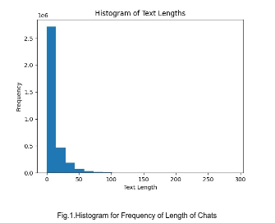
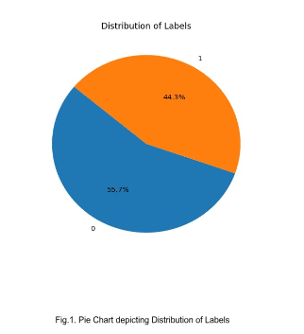
Preprocessing is required in order to perform text cleaning by removing the number of duplicate chats and Non-ASCII,special characters, tokenizing.Detailed description in following slides
Post removal of duplicates-No of rows- 3,508,663(almost halved)

Slide 9
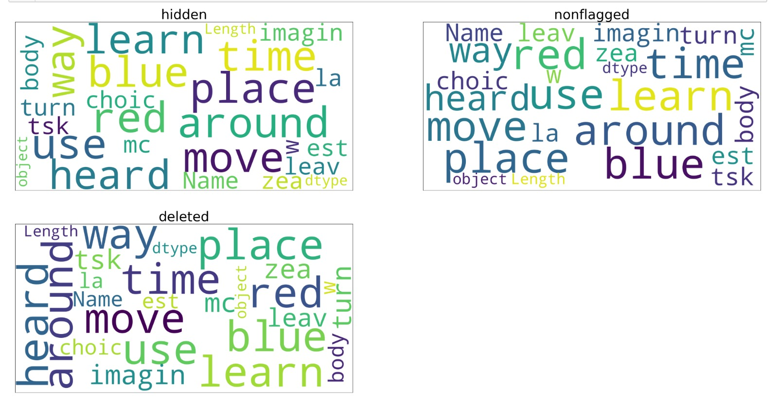
Word Cloud-Representing the commonly occurring words

Slide 10
Methodology
To preprocess the data we used some following methods.
Converting all the parquet files of the dataset into one single csv file.
Removing any duplicate characters, Non-ascii characters and
special characters.
Lowercasing all the characters and words.
Tokenization for splitting the long sentences into smaller chunks.
Contractions were expanded.Eg- don’t was changed to do not.

Slide 11
Tf-Idf, Word2Vec and Fasttext vectorizer to convert sentences into vectors for performing Logistic Regression , SVM ,etc.
Machine Learning Models were implemented on the following data split postprocessing-
test:train(20:80)
Following libraries were used in implementation of the methods-numpy, pandas,sklearn, sea born, matplot.lib, contractions

Slide 12
Models include-
Logistic Regression
Naive Bayes
Decision Trees
Random Forest
SVM
XG Boost
MLP
RNN

Slide 13
Results and Analysis
After performing Logistic Regression-
Max_Iteration-10,000
Moderate Accuracy of 65%
70% correct prediction of actual positives (label = 1) as positives
Accuracy | 0.65
Precision | 0.70
Recall | 0.36
F1 Score | 0.48

Slide 14
Classification Report
Macro Averages of Precision, Recall, F1 Score are 0.67, 0.62, 0.61
Weighted averages of Precision, Recall, F1 Score are 0.67, 0.65, 0.62
For negative class = High Recall (0.88), Low Precision (0.64). Most negative classes got identified
For positive class = Low Recall (0.37), Good Precision (0.70). Predicts the positive classes with good accuracy.
Label | Precision | Recall | F1 Score | Support
0 | 0.64 | 0.88 | 0.74 | 0.39
1 | 0.70 | 0.37 | 0.48 | 0.31

Slide 15
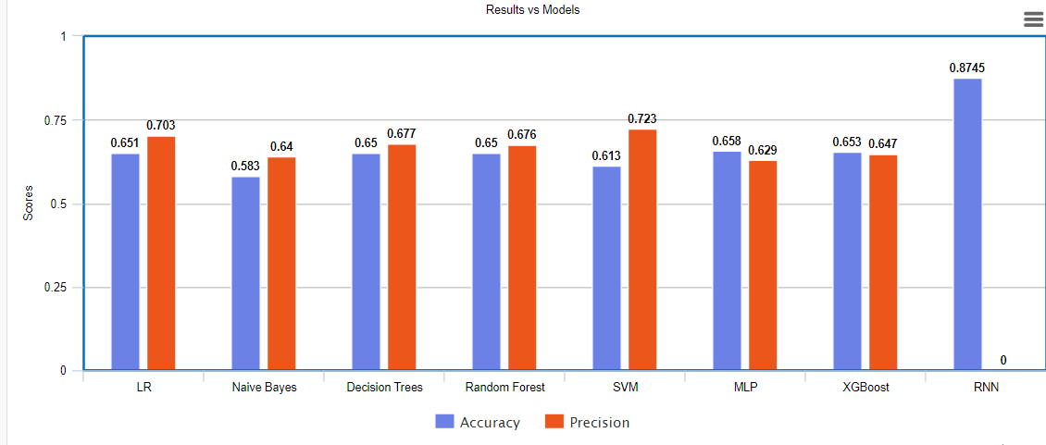
Results Overview

Slide 16
Naive Bayes
Bayes probability to determine the probability of a word being in a certain category; toxic or not toxic.
Assumes that the words are independent in a text.
0-1 loss function
Used Multinomial Naive Bayes
Contains laplace Smoothing
Better for textual and sparse data
Smoothing Parameter = 15,00,000 (Avoids 0 probabilities)
Fit_prior = False (Assumes Uniform distribution of classes)

Slide 17
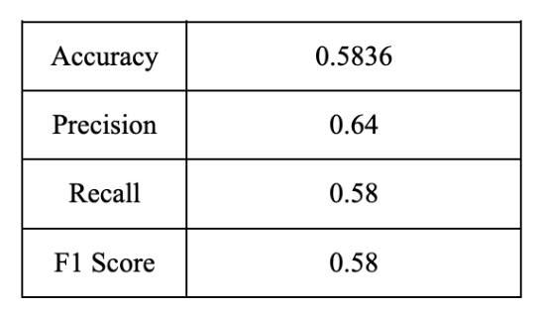
Naive Bayes: Results
64% of the positive predictions are correct.
58% of positive texts were identified correctly.
Why the result!
Naive Assumption of
the model may not work
for this data.

Slide 18
Decision Trees
Recursively split data based on features to create a tree-like structure for decision-making
6000 = min_samples. So a node will not be splitting if it does not have at least 6000 samples.
At each step of splitting max_features = 12, so we will select only 12 random features for splitting.
Entropy as splitting criterion
Decision Trees are prone to overfitting so we have used max_depth = 8

Slide 19
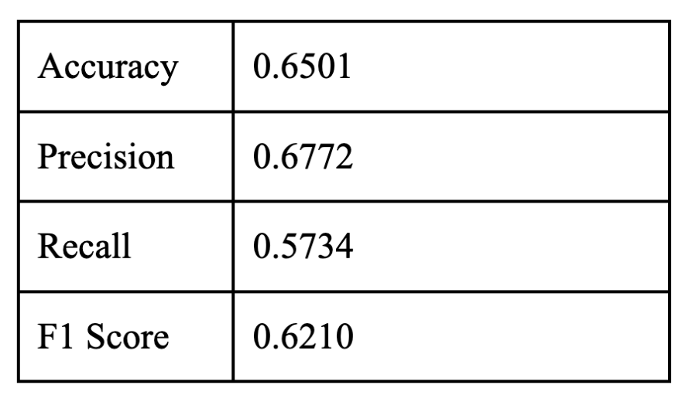
DT : Results
65% of the positive predictions are correct.
67% of positive texts were identified correctly.
Why the result!
Not suited to capture non
linear relationships.
Sensitive to noise

Slide 20
Random Forest
Random Forests are an ensemble learning method that constructs multiple decision trees during training and outputs the mode of the classes for classification or mean prediction for regression.
Robust to overfitting.
n_estimators = 20. 20 trees in the model.
Gini Impurity as splitting criterion.
Maximum Depth = 8. To control overfitting of decision trees.
Minimum samples required to split a node = 5300.
Maximum features = 32. Limiting the features we can add diversity in a tree.

Slide 21
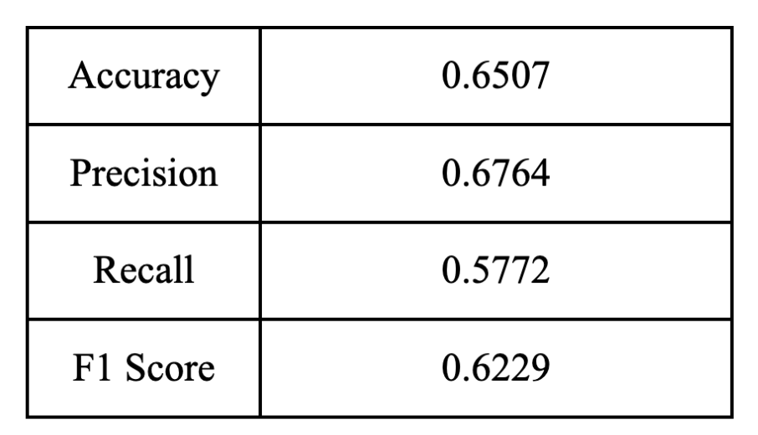
Random Forest: Results
65% of the positive predictions are correct.
67% of positive texts were identified correctly.
Why the result!
Ignores the sequential
and contextual informat-
ion of words.

Slide 22
RNN
Captures sequential dependencies in the text.
Can understand the contextual relationships between the words.
It can remember information from earlier part of the text.
Embedding layer with 32 dimension output. (Moderate complexity)
3 simple RNN layers of 64 with 0.1 dropout (Regularization)
Added a dense layer with sigmoid activation function (Binary class.)
Used Binary Cross Entropy for loss (Binary classification)
Adam Optimiser (Learning rate adaptation for each parameter)
7 epochs (Balancing complexity)

Slide 23
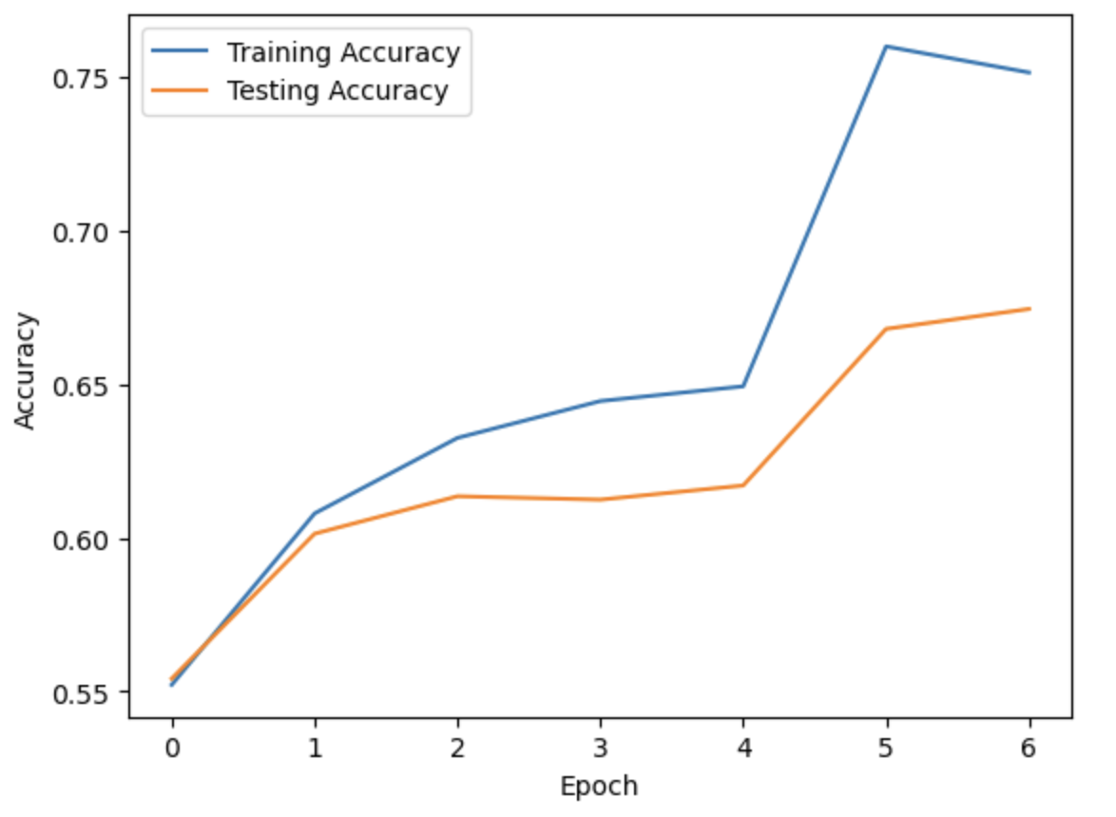
RNN Results
Trained 6,64,000 parameters.
Accuracy = 0.8745
Why the result.
Does not ignore the sequential
and contextual
information of words.
The data has a lot of noise

Slide 24
SVM
Subsampled Dataset-2,00,000 data points compared to 3.5 million
Reasons
-High dimensional data post vectorizing(increased sparsity)
-Large no. of datapoints
-High Computation Cost and Time

Slide 25
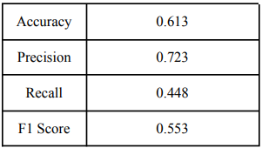
SVM:Results
Training Complete Dataset not computational feasible
Subsampled Dataset-2,00,000 data points compared to 3.5 million
Why the result
Sequential and contextual data
Subsampled dataset

Slide 26
XGBOOST
XGBoost is an optimized distributed gradient boosting algorithm which is designed to be highly efficient, flexible and able to handle higher dimensional data like sparse datasets and it has lower computational expenses.
Since XGBoost uses Decision trees and uses greedy algorithm for split finding which makes the split finding process quick enough.
Here we have used binary logistic as its hyperparameters with vectorizers as fasttext and word2vec..

Slide 27
XGBOOST Results
Here we found that around
65% of the positive predictions are correct and 64% of positive texts were identified correctly.
Accuracy | 0.65385
Precision | 0.6470792285278202
Recall | 0.515702753511003
F1 Score | 0.5739692307692308

Slide 28
MLP
MLP based neural networks can handle unorganized data by large volumes of raw data to train the model upon the datasets additionally it is computationally expensive.
It can improve upon accuracy of the ML model as by practicing continuous learning we can train the ML model multiple times.
Activation function = relu
Solver = adam
Learning rate = 0.01
Hidden layer = 100

Slide 29
MLP Results
Here we got our analysis as
Around 65% of positive predictions are correct and around 62% of positive texts were identified correctly.
Accuracy | 0.658175
Precision | 0.629557865069579
Recall | 0.5928342364259649
F1 Score | 0.6106444172338183

Slide 30
Conclusion and learnings
RNN best suited
Word2Vec/Fasttext better at contextually vectorizing compared to TF-IDF
Data suited for Sequential Modeling compared to Binary Classification in fixed dimension
Suggested Models-
Long Short-Term Memory (LSTM) Networks
Gated Recurrent Units (GRUs)
Transformer Models

Slide 31
Individual Contribution
Aniket Malik- Data analysis and visualisation,Data Preproccessing,Vectorization,Logistic Regression,SVM,Preparing Proposal,Report, Presentation
Mayank Jha-Literature Review,Preparing Presentation, Data Visualization, Vectorization, Decision Trees, Random Forest, Naive Bayes, Recurrent Neural Network.
Piyush Gautam- Dataset description,analysis,Data Preprocessing,Preparing Presentation, XGBoost, MLP

